Slide 1
Quasi-Recurrent Neural Networks
ICLR 2017 paper
QRNNs compute intermediate representations from the input in parallel
QRNNs handle sequential dependencies using pooling

Slide 2
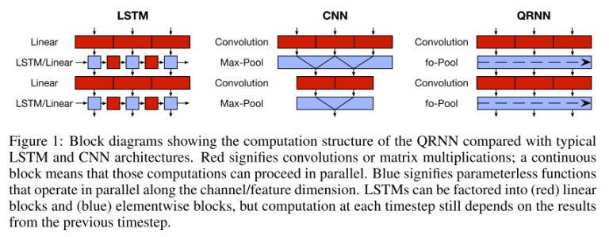
QRNNs are build using a convolution layer and a pooling layer.
Uses a convolutional layer to compute intermediate representations
Then use pooling to handle sequential dependencies.

Slide 3
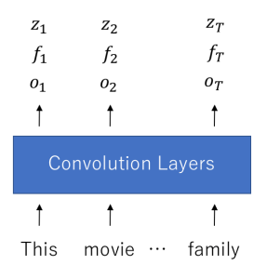
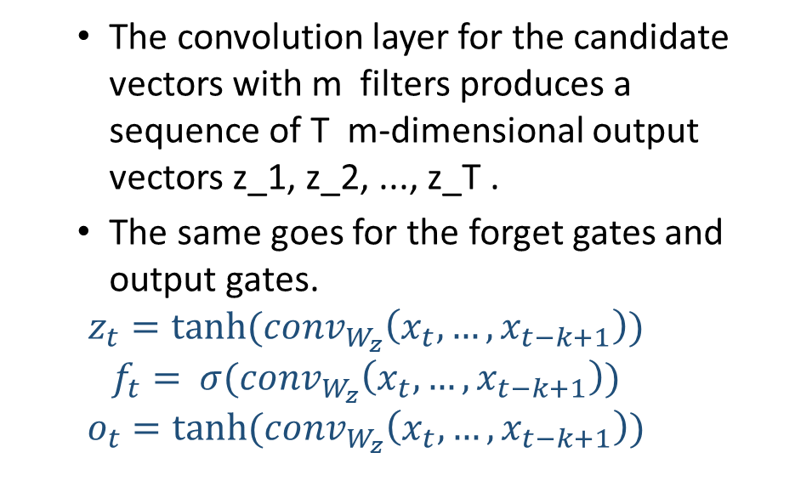
Step 1: APPLY CONVOLUTIONS TO COMPUTE INTERMEDIATE VECTORS AND GATING VECTORS
Convolution layer1 computes three vectors for each input:
a candidate vector, a forget gate, and an output gate
Given an input sequence of n-dimensional vectors x_1, x_2, ... x_T
The convolution layer for the candidate vectors with m filters produces a sequence of T m-dimensional output vectors z_1, z_2, ..., z_T .
The same goes for the forget gates and output gates.
$$z_{t}=tanh⁡({conv}_{W_{z}}\left(x_{t}, …,x_{t−k+1}\right))$$
$$f_{t}=⁡σ({conv}_{W_{z}}\left(x_{t}, …,x_{t−k+1}\right))$$
$$o_{t}=tanh⁡({conv}_{W_{z}}\left(x_{t}, …,x_{t−k+1}\right))$$

Slide 4
STEP 2: POOL USING GATING
The QRNN computes the hidden states (outputs) according to the following equation
Difference with LSTM: the sequential processing only occurs in the pooling layer and the values of z_t , f_t , and o_t do not depend on any previous values.

